Slide 1
Database Administration
Lecture 1 Introduction

Slide 2
Course Description
This course will cover real time database administration tasks using SQL Server.
This course provides students with sound knowledge in the following: installation, configure and support databases, managing storage, setting up user accounts, assigning permissions, securing databases, backing up and restoring databases, tuning the performance of database and performing other administrative tasks. This course will cover theory (concepts) and practical (lab sessions). The pre-requisite for this course is Database Systems Design.

Slide 3
Course Objective
Make students understand the concept & architecture of modern database and the key role of a database administrator
Provide skills to plan and manage for a commercial database software
Train students to apply backup and recovery tasks
Train students to automate administrative tasks monitor and optimize performance
Provide students with troubleshooting skills

Slide 4
What is SQL Server?
Microsoft SQL Server is a relational database management system (RDBMS), part of the Microsoft Enterprise Library.
It was initially developed by Microsoft in 1989.
The system is designed to manage and store data.
Like other Relational Database Management Software, SQL Server is based on SQL, a programming language for accessing and manipulating relational databases.

Slide 5
What is SQL Server?
SQL Server runs on various operating systems, including Linux, Windows, and UNIX.
You can also run it on Azure.
Azure is a public cloud computing platform
It is both GUI and command based software.

Slide 6
SQL Server Version History
Product | Compatibility Level Value
SQL Server 1.0 (1989) | -
… | …
SQL Server 2005 (9.x) | 90
SQL Server 2008 | 100
SQL Server 2012 (11.x) | 110
SQL Server 2014 (12.x) | 120
SQL Server 2016 (13.x) | 130
SQL Server 2017 (14.x) | 140
SQL Server 2019 (15.x) | 150
SQL Server 2022 (16.x) | 160

Slide 7
Popular SQL Server editions
Different editions have its features.
the following are some SQL Server versions provided by Microsoft SQL Server.
SQL Server Enterprise edition
SQL Server business intelligence edition
SQL Server standard edition
SQL server web edition
SQL Server developer edition
SQL Server Express edition

Slide 8
Popular SQL Server editions
Enterprise edition
the top-end edition with a full feature set.
Standard edition
It has less features than Enterprise
Express edition
This is free entry level database. It can utilize only 1 CPU and 1 GB memory, the maximum size of the database is 10 GB.
Developer edition
This is similar to Enterprise, but licensed to only one user for development, testing and demo

Slide 9
SQL Server Components
SQL Server works in client-server architecture, hence it supports two types of components − (a) Workstation and (b) Server.
Workstation components are installed in every device/SQL Server operator’s machine. These are just interfaces to interact with Server components.
Server components are installed in centralized server. These are services. Example: SQL Server, SQL Server Agent

Slide 10
Database Administrator
Database administrator is a person who has a central control of both the data and the programs
that access those data. This control includes:
Installing and upgrading database server and application tools.
Allocating and planning system storage such as memory, disk space, network requirements and so on.
Maintaining system security by granting authorization and permission.
Creating backup and recovery strategy.

Slide 11
Database Administrator
Monitoring technical support for both database system and application.
Modifying database structures as needed.
Migrating database instances to new hardware.
Managing and monitoring data replication.
Managing the automated tasks of the database.
Optimizing the performance of the database

Slide 12
Database administrators
Database administrators (DBAs) use specialized software to store and organize data.
The role may include capacity planning, installation, configuration, database design, migration, performance monitoring, security, troubleshooting, as well as backup and data recovery.

Slide 13
What You should Know!
Basic understanding of Transact-SQL (main commands, Programmability)
Basic Relational Database theory

Slide 14
Planning Your installation
MS provides volumes of information to help you in using products.
Which Edition of SQL server (it is all about features)
Minimum Action and Knowledge:
Educated Estimate of growth (why are you upgrading? Users, functionality, new app!! How much is the growth!
Required H/W and S/W (goo.gl/mjXH4e) But never go with the minimums, s/w required like: (you may meet errors or warnings)
.NET framework ?? SP ?, windows PowerShell ??, network s/w TCP/IP
Storage system

Slide 15
SQL Server 2019: Hardware and software requirements
Hardware requirements
Component | Requirement
Hard Disk | minimum of 6 GB of available hard-disk space.
Monitor | requires Super-VGA (800x600) or higher resolution monitor.
Memory * | Minimum: Express Editions: 512 MB All other editions: 1 GB Recommended: Express Editions: 1 GB All other editions: At least 4 GB
Processor Speed | Minimum: x64 Processor: 1.4 GHz Recommended: 2.0 GHz or faster

Slide 16
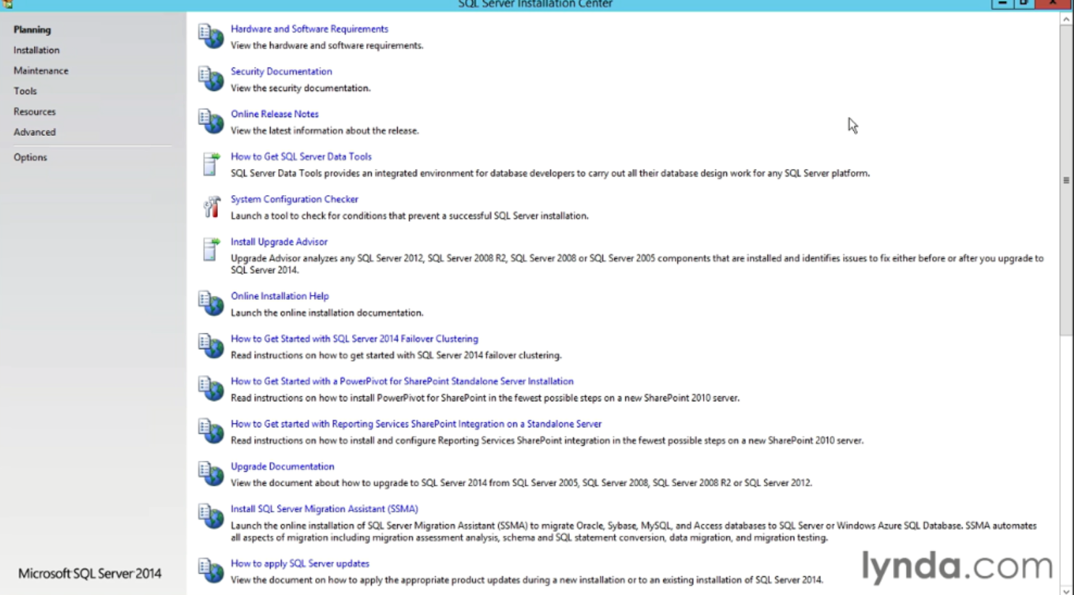
Installing SQL server

Slide 17
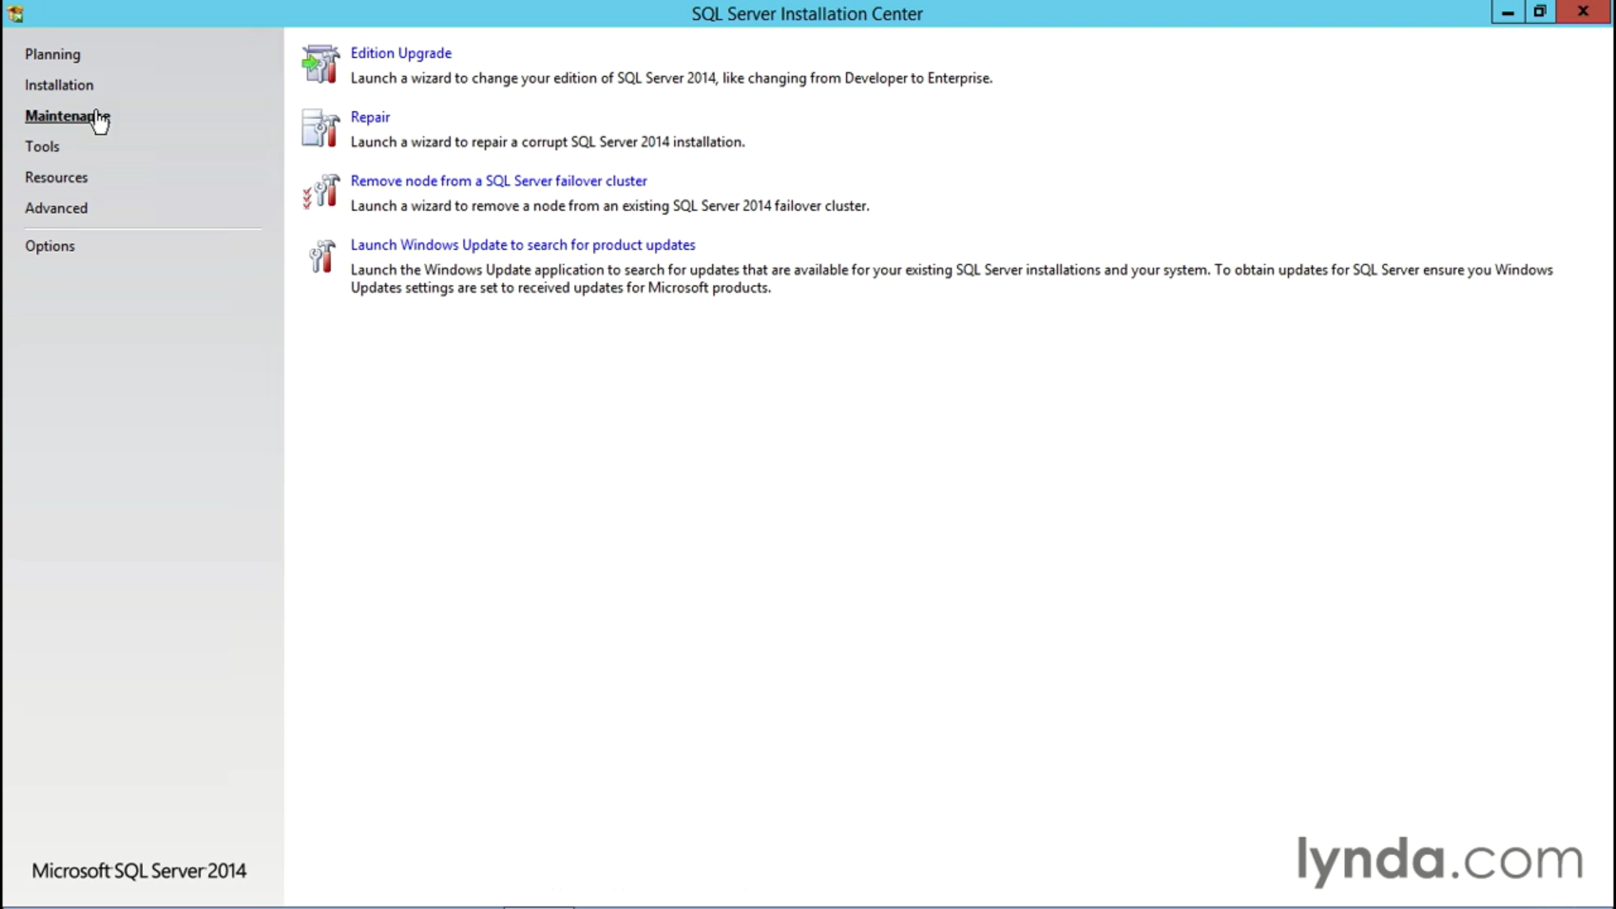

Slide 18
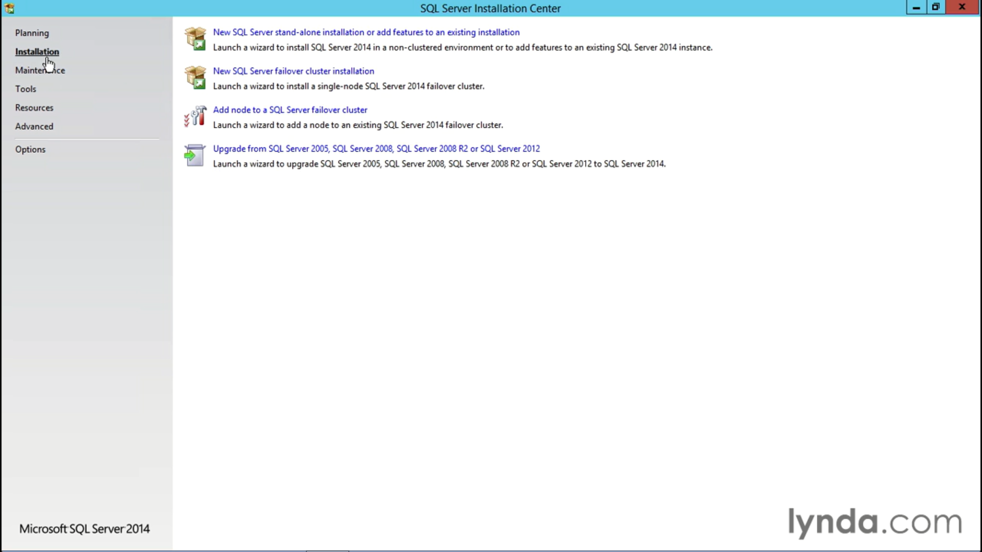

Slide 19
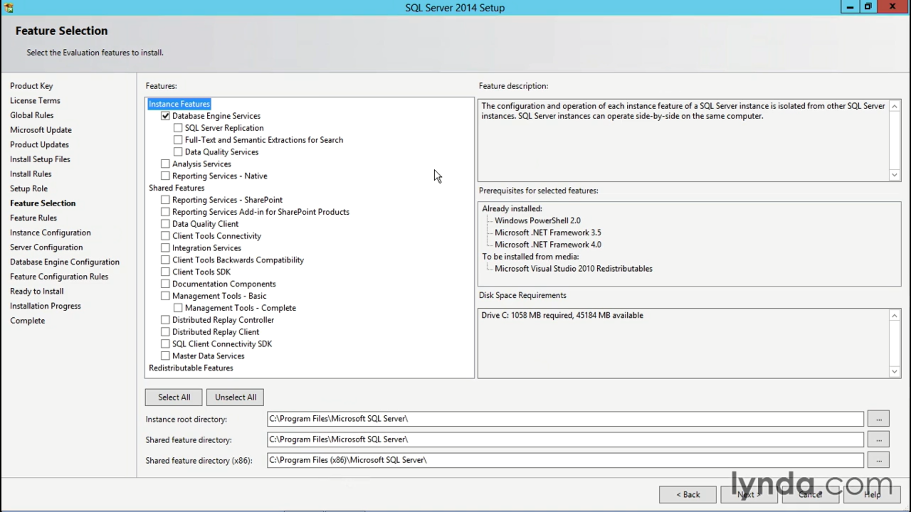

Slide 20
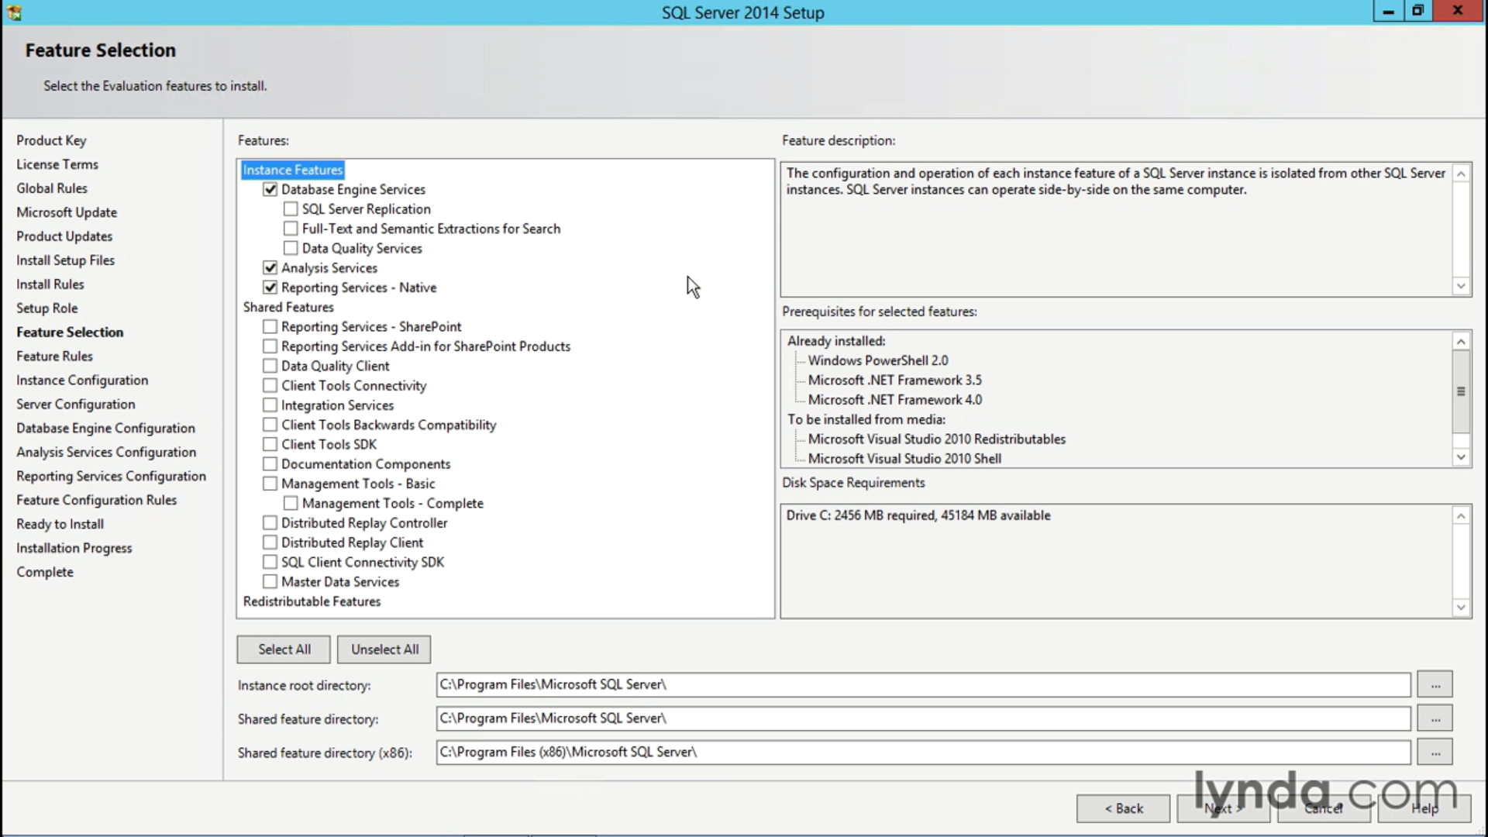

Slide 21
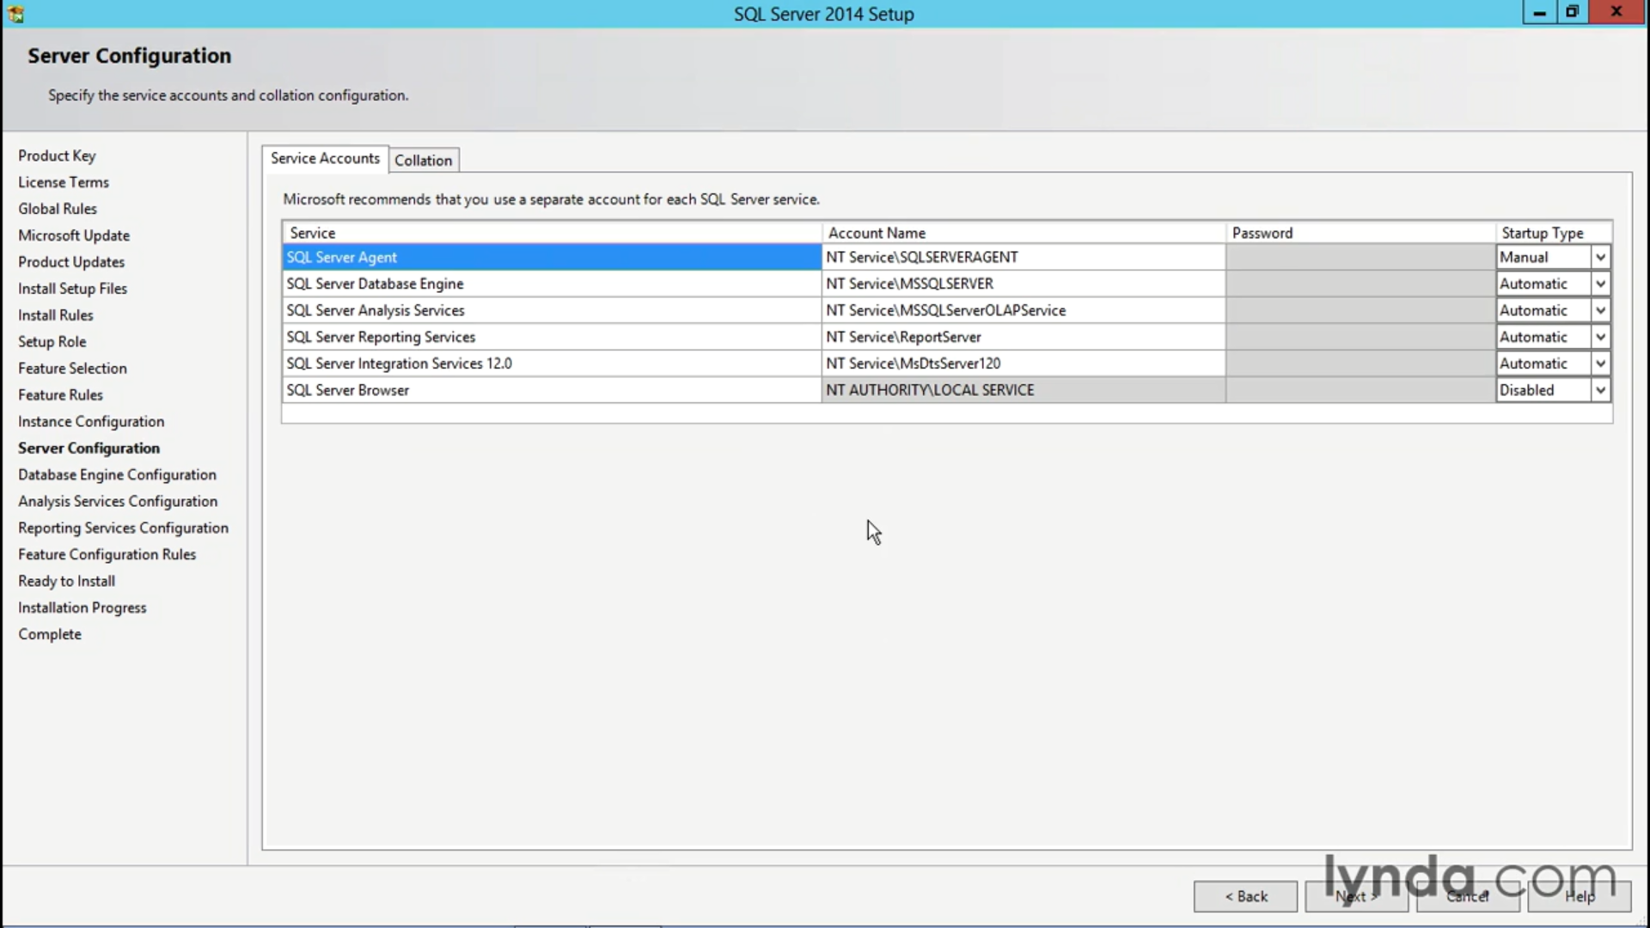

Slide 22
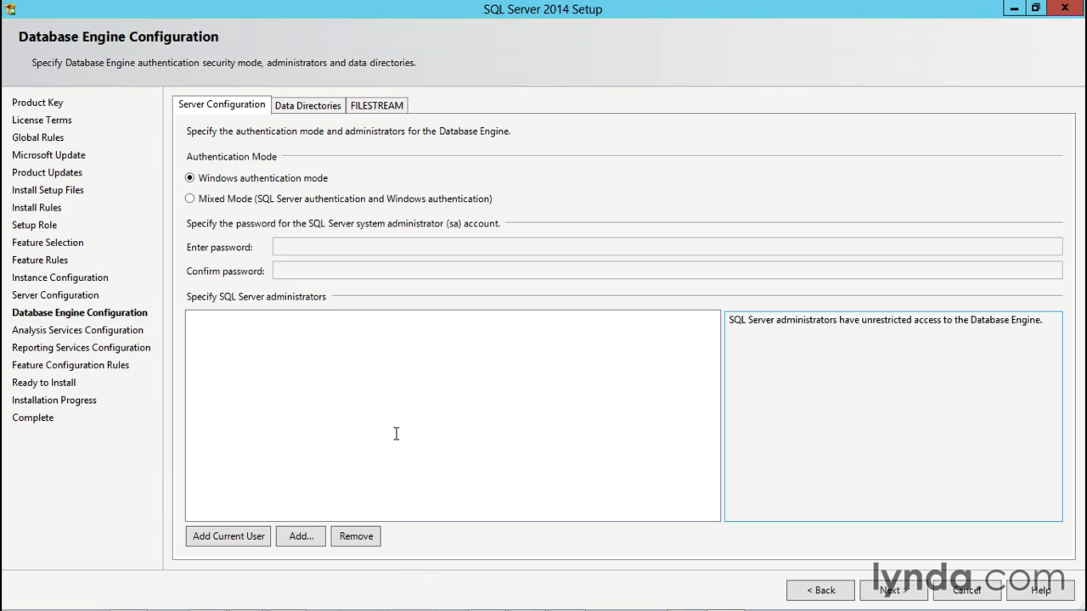

Slide 23
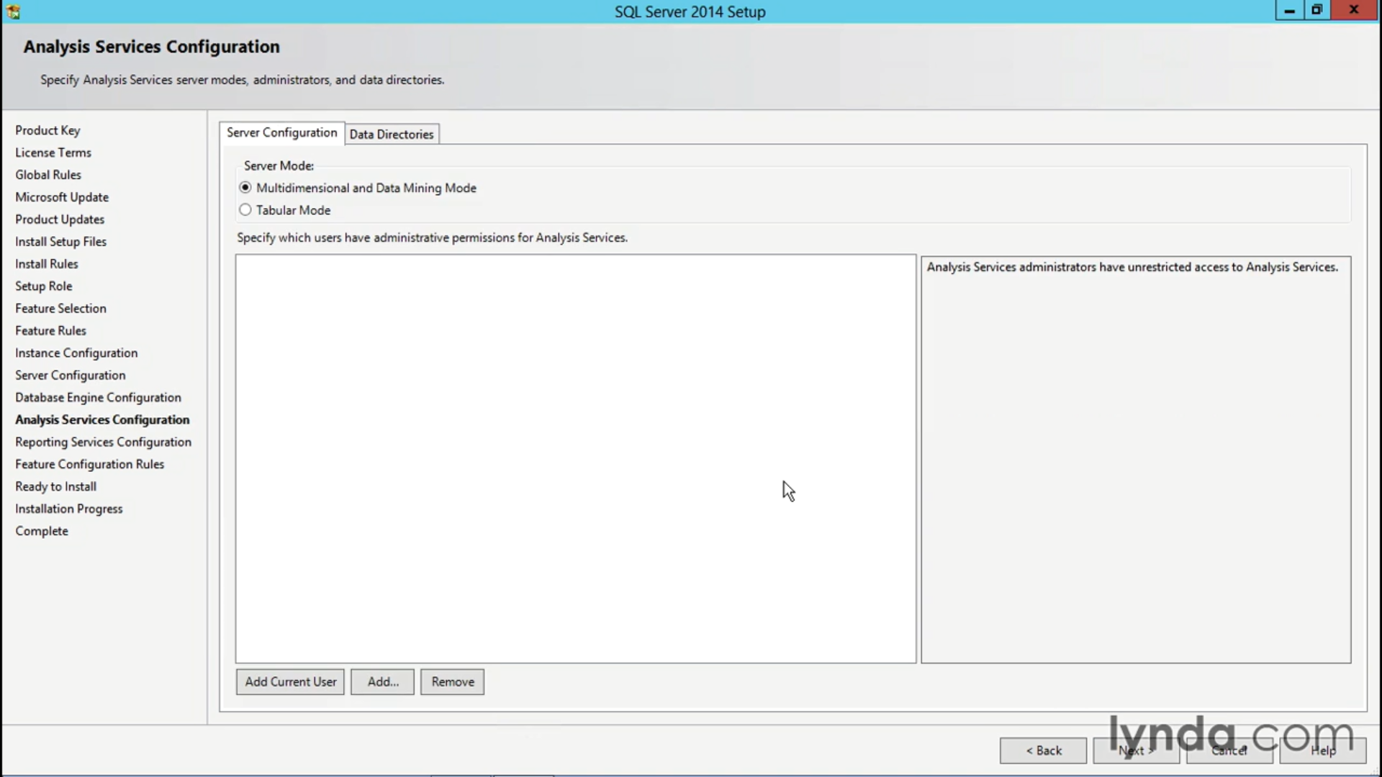

Slide 24
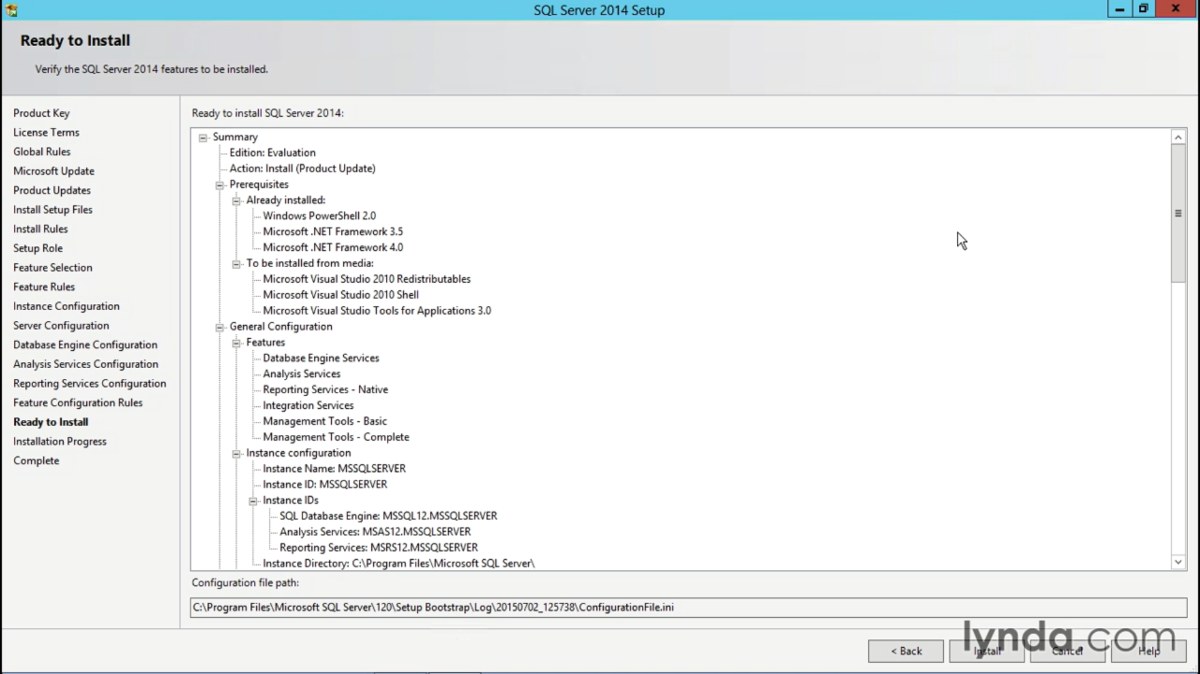

Slide 25
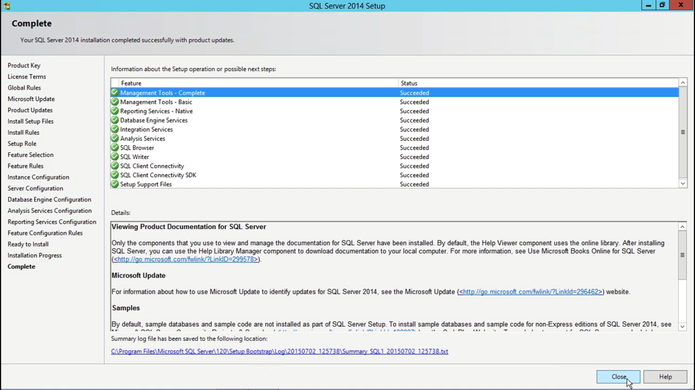

Slide 26
SQL Server instance
A SQL Server instance refers to a running installation of Microsoft SQL Server on a server or a computer. It represents a distinct and independent copy of the SQL Server software that can host multiple databases.

Slide 27
Here are a few key points about SQL Server instances:
Multiple Instances: A server or computer can have multiple instances of SQL Server installed. Each instance operates independently, with its own set of databases, configurations, and resources.
Instance Names: Each SQL Server instance is identified by a unique name, known as the instance name. The instance name is used to connect to and manage a specific SQL Server instance. By default, the default instance is named "MSSQLSERVER," but named instances can have custom names.
Port Numbers: SQL Server instances listen on specific port numbers to communicate with client applications. The default instance listens on port 1433, while named instances use dynamic port assignment or specified port numbers.
Resource Allocation: Each SQL Server instance has its own allocated resources, such as memory, CPU, and disk space.
Service Control: SQL Server instances run as Windows services, which can be started, stopped, and configured independently. This allows individual control and management of each instance's service.

